Slide 1
RUNGTA COLLEGE OF DENTAL SCIENCES & RESEARCH
PIT AND FISSURE SEALANTS
DEPARTMENT OF PEDODONTICS AND PREVENTIVE DENTISTRY

Slide 2
Specific learning Objectives
Core areas | Domain
DEFINITIONS PREVENTIVE TECHNIQUES FOR CARIES OF OCC SURFACES CLASSIFICATION MATERIALS USED AS PFS RATIONALE FOR USE OF PFS INDICATIONS CONTRAINDICATIONS | TYPES/MORPHOLOGY OF FISSURES HISTOPATHOLOGY OF CARIES IN PF TECHNIQUE FOR SEALANT APPLICATION CLINICAL PROBLEMS WITH SEALANT USE PRR RECENT ADVANCES

Slide 3
Category
MUST TO KNOW
NEED TO KNOW
Fissure sealant cycle
DESIRE TO KNOW
Current status of pit and fissure sealant
Types of pit and fissure sealants
Pit and fissure usage
Morphology of pit and fissure
Clinical technique for placement of pit and fissure sealant

Slide 4
CONTENTS ;
INTRODUCTION
EVOLUTION OF PFS
DEFINITIONS
PREVENTIVE TECHNIQUES FOR CARIES OF OCC SURFACES
MICROFLORA OF PF
CLASSIFICATION
MATERIALS USED AS PFS
RATIONALE FOR USE OF PFS
INDICATIONS

Slide 5
CONTRAINDICATIONS
REQUIREMENTS OF OCC SEALANTS
TYPES/MORPHOLOGY OF FISSURES
HISTOPATHOLOGY OF CARIES IN PF
TECHNIQUE FOR SEALANT APPLICATION
CLINICAL PROBLEMS WITH SEALANT USE
PRR
RECENT ADVANCES
CONCLUSION
REFERENCES

Slide 6
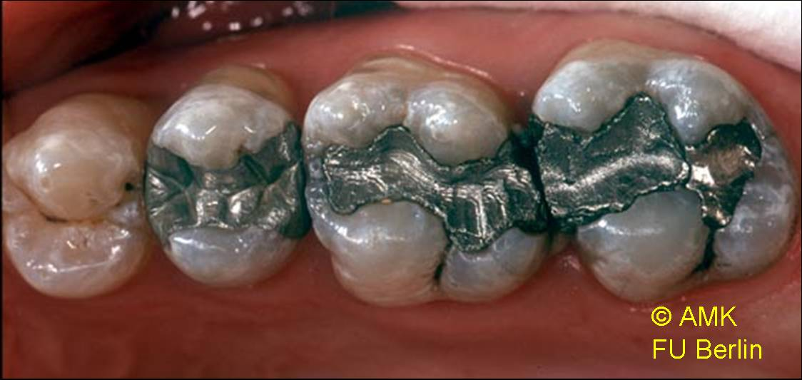
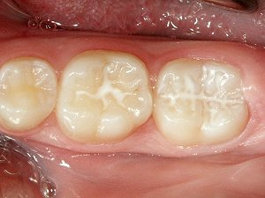
I
N
T
R
O
D
U
C
T
I
O
N

Slide 7
EVOLUTION OF PIT AND FISSURE SEALANTS
1976- first colored sealant- CONCISE WHITE SEALANT (3M dental products)
1984- Burt reported- “first and second molars should be sealed as soon as possible after eruption because of their susceptibility to occlusal caries”
1989- Eccles noted- “fissure sealant should be used preventively for caries prone patient, and
therapeutically for suspect or early carious lesion

Slide 8
DEFINITIONS:
Pit: is defined as small pin point depression located at the junction of developmental grooves or at terminals of those grooves.
Fissure: is defined as deep clefts between adjoining cusps.
They provide areas for retention of caries producing agents.
Pit and Fissure Sealant: is used to describe a material that is introduced into the occlusal pit and fissure of caries susceptible teeth, thus forming a micromechanically–bonded, protective layer cutting access of caries producing bacteria from their source of nutrients

Slide 9
MICROFLORA OF PIT AND FISSURES —
Cocci constitute – 75% to 95% of microorganisms
S.Sanguis – Predominant viable microorganisms
S.Mutans and Lactobacilli –
low in newly formed plaque in fissures
over time
Fusiforms, Spirillae and Spirochetes are
absent

Slide 10
CLASSIFICATION OF SEALANTS –
BASED ON GENERATION –
A. First generation sealants:
- polymerized by UV-light at a wavelength 356 μm.
- disad.: -Excessive absorption and incomplete polymerization of sealant at its depth.
- variable output intensity
- output not uniform
B. Second generation Sealants/Self curing resins
- Based on catalyst – accelerator system
- Most are unfilled.
- May be transparent, tinted or opaque by inclusion of white pigment or a tint for better visualization.
eg . Concise [3M] white sealant system, Delton.

Slide 11
C. Third generation sealants:
-Light cured by visible light at wavelength 430 nm-490nm.
- May be classified as filled or unfilled, and with or with out tint or opaquer.
-Most of the unfilled resins are colored white.
-Filled resins are either clear, yellowish white or tan
PERFORM BETTER THAN SELF CURE RESINS
D. Fourth generation sealants:
-Are those containing fluorides.

Slide 12
BASED ON FILLER CONTENT:
Unfilled [ free of fillers ]
-flow is better
-retention is more
-abrade rapidly
eg . Concise White
2. Filled
- need for occlusal adjustments
- more resistant to wear
eg. Prisma shield

Slide 13
BASED ON TRANSLUCENCY :
1. CLEAR
-Esthetic, but difficult to detect at recall examination.
-Better flow than tinted or opaque
-More easily appreciated by the patient.
2. TINTED / OPAQUE
- can be easily identified
COLOURED
-easy to see during placement
-easy to see during recall check up

Slide 14
BASED ON CURING:
1. AUTOPOLYMERIZING .
- Better retention 88%
- Sets by exothermic reaction
2. LIGHT CURE
- 75% retentive

Slide 15
INDICATIONS :
RISK-BASED SEALANT TREATMENT
Possibility of adequate isolation
Questionable enamel caries in PF
Xerostomia
Patients undergoing orthodontic treatment
Deep pits and fissures

Slide 16
CONTRAINDICATIONS ;
Posterior teeth that have shallow or well coalesced fissures
Low caries risk (PF that remained caries free > 4 yrs)
Rampant caries
Teeth with proximal decay or occlusal caries involving dentine
Allergy to methacrylate
Semi-erupted teeth

Slide 17
TYPES OF OCCLUSAL FISSURES:
V – Wide at top and gradually narrowing towards the bottom (34%)
U – Almost same width from top to bottom (14%)
IK – Hourglass, extremely narrow slit associated with a large space at the bottom (26%).
λ – Inverted Y, bifurcating at the bottom (7%).
I – Extremely narrow slit (19%).

Slide 18
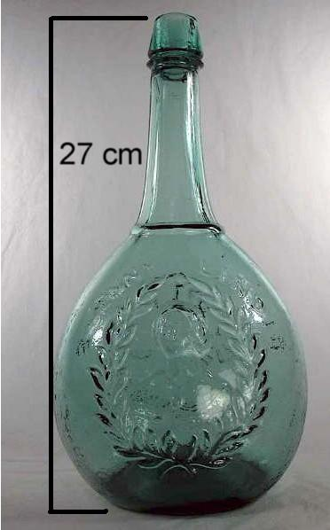
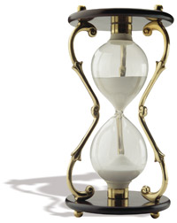

Slide 19
TECHNIQUE FOR SEALANT APPLICATION –
PREPARATION OF TOOTH
ISOLATION
DRYING THE TOOTH
ETCHING OF TOOTH SURFACE
RINSING AND DRYING OF TOOTH
PLACEMENT AND POLYMERIZATION OF SEALANT
OCCLUSAL EVALUATION

Slide 20
TECH. FOR SEALANT APPLICATION
Washing and drying :
REMOVE ALL ACID AND REACTIONARY PRECIPITATES
Rinse with water for 10-20 seconds and dried for additional 10 sec
Water under pressure in air-water spray + high power evacuation
Evacuator tip placed above/adjacent the tooth and water directed to the tip
20 sec/tooth OR 30 sec/quadrant

Slide 21
TECH. FOR SEALANT APPLICATION
Sealant application --
Sealant applied with disposable bristle brush
For autopolymerizing resins – cover etched areas on each tooth as quickly as possible with sealant and then bulk can be added
For light curing resins – no mixing necessary and hence reduced bubbles
Sealant applied should be –
too much
thick
THUS TOTAL TIME FOR SEALANT APPLICATION SHOULD TAKE
3 ½ MIN

Slide 22
TECH. FOR SEALANT APPLICATION
Adjustment and recall –
Surface wiped off to remove surface film – inspection of surface
Occlusion checked with articulating papers
Occlusal interferences removed
Filled sealants adjusted with green stone
Sealants should be evaluated every 6 mnths
Bite-wing RG: detect caries progression under sealants

Slide 23
CHILDREN | RISK FACTORS
1.LOW RISK | No new/incipient caries in past year Good oral hygiene Regular dental visits
2.MODERATE RISK | One new, incipient/recurrent caries in past year Deep PF High familial caries experience Early childhood caries Frequent sugar exposure Decreased salivary flow Compromised oral hygiene Irregular dental visits Inadequate fluoride exposure
3.HIGH RISK | Two or more new or recurrent carious lesions in past year Deep PF Sibling or parents with high caries rate History of pit and fissure caries Early childhood caries Frequent sugar exposures Decreased salivary flow

Slide 24
PREVENTIVE RESIN RESTORATIONS (PRR)–
FISSURE SEALANT OR SEALANT RESTORATION
It is a natural extension of Pit and Fissure sealants.
INDICATIONS
Tooth can be isolated.
No, or only minimal pit and fissure staining
Minimal “catches” in the grooves, or areas with distinct incipient enamel caries.
No evidence of radiographic caries.

Slide 25
TYPE OF SEALANT RESTORATION | INDICATIONS
1. Sealant alone | Decalcified fissure No RG involvement of dentin Less than 2 other carious lesions in mouth
2. Composite + Sealant | More than 2 other carious lesions in mouth Lesion confined to dentin
3. GIC + Sealant | Cavity in dentin but confined Margins not in occlusal contact
4. Laminate restoration | Lesion in dentin and lateral spread along DEJ Cavity margins in occlusal contact
5. Amalgam restoration | Large radiolucency in dentin Significant lateral spread of caries

Slide 26
RECENT ADVANCES :
Use of surfactant containing etchant – lower surface tension and contact angle
Use of argon laser for polymerization
Use of Er: YAG laser
Carbon dioxide conditioning
Use of DIAGNOdent – detection of caries
under pit and fissures

Slide 27
Take Away Home Message
Pit and fissure sealant Nuva seal developed and commercially introduced by LD Caulk company in 1971
Fissure types include V,U,I,IK inverted Y more prone to caries.
Clear pit and fissure sealant- Helioseal
Coloured pit and fissured sealant-CLINPRO

Slide 28
REFERENCES
Fundamentals of paediatric dent.- R.MATHEWSON
Dentistry for child and adolescent – Mc DONALD
Pediatric dentistry – STEWART
Textbook of pedodontics – SHOBHA TANDON
Pediatric dentistry: infancy through adolescence- PINKHAM
T.B of pediatric dent. – BRAHAM MORRIS
Cariology – NEWBRUN
Pit and fissure sealants: review of literature
(pediatric dentistry 2002)

